Slide 1
Inter Process Communication

Slide 2
Interprocess Communication
Processes within a system may be independent or cooperating
Cooperating process can affect or be affected by other processes, including sharing data
Reasons for cooperating processes:
Information sharing
Computation speedup
Modularity
Convenience
Cooperating processes need interprocess communication (IPC)
Two models of IPC
Shared memory
Message passing

Slide 3
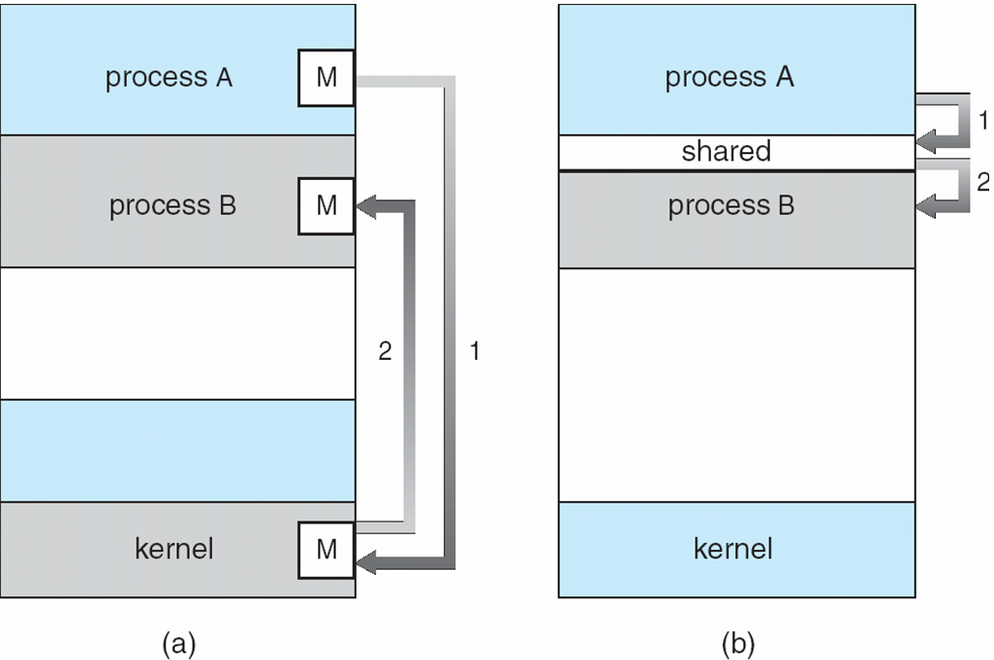
Communications Models

Slide 4
Cooperating Processes
Independent process cannot affect or be affected by the execution of another process
Cooperating process can affect or be affected by the execution of another process
Advantages of process cooperation
Information sharing
Computation speed-up
Modularity
Convenience

Slide 5
Interprocess Communication – Message Passing
Mechanism for processes to communicate and to synchronize their actions
Message system – processes communicate with each other without resorting to shared variables
IPC facility provides two operations:
send(message) – message size fixed or variable
receive(message)
If P and Q wish to communicate, they need to:
establish a communication link between them
exchange messages via send/receive
Implementation of communication link
physical (e.g., shared memory, hardware bus)
logical (e.g., logical properties)

Slide 6
Direct Communication
Processes must name each other explicitly:
send (P, message) – send a message to process P
receive(Q, message) – receive a message from process Q
Properties of communication link
Links are established automatically
A link is associated with exactly one pair of communicating processes
Between each pair there exists exactly one link
The link may be unidirectional, but is usually bi-directional

Slide 7
Indirect Communication
Messages are directed and received from mailboxes (also referred to as ports)
Each mailbox has a unique id
Processes can communicate only if they share a mailbox
Properties of communication link
Link established only if processes share a common mailbox
A link may be associated with many processes
Each pair of processes may share several communication links
Link may be unidirectional or bi-directional

Slide 8
Indirect Communication
Operations
create a new mailbox
send and receive messages through mailbox
destroy a mailbox
Primitives are defined as:
send(A, message) – send a message to mailbox A
receive(A, message) – receive a message from mailbox A

Slide 9
Synchronization
Message passing may be either blocking or non-blocking
Blocking is considered synchronous
Blocking send has the sender block until the message is received
Blocking receive has the receiver block until a message is available
Non-blocking is considered asynchronous
Non-blocking send has the sender send the message and continue
Non-blocking receive has the receiver receive a valid message or null

Slide 10
Buffering
Queue of messages attached to the link; implemented in one of three ways
1. Zero capacity – 0 messages Sender must wait for receiver (rendezvous)
2. Bounded capacity – finite length of n messages Sender must wait if link full
3. Unbounded capacity – infinite length Sender never waits

Slide 11
Communications in Client-Server Systems
Sockets
Remote Procedure Calls
Pipes
Remote Method Invocation (Java)

Slide 12
Sockets
A socket is defined as an endpoint for communication
Concatenation of IP address and port
The socket 161.25.19.8:1625 refers to port 1625 on host 161.25.19.8
Communication consists between a pair of sockets

Slide 13
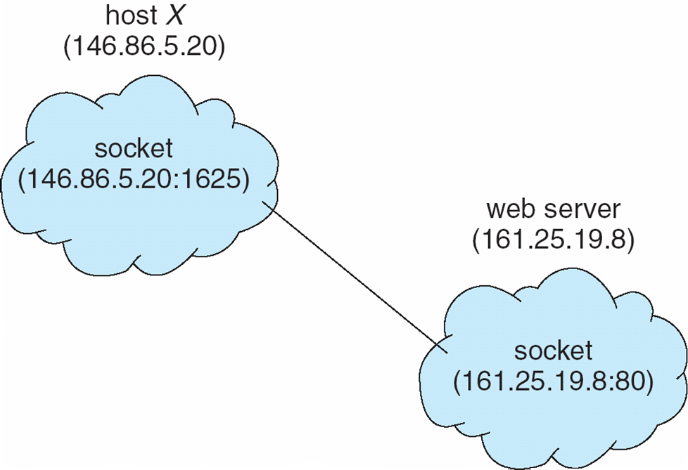
Socket Communication

Slide 14
Remote Procedure Calls
Remote procedure call (RPC) abstracts procedure calls between processes on networked systems
Stubs – client-side proxy for the actual procedure on the server
The client-side stub locates the server and marshalls the parameters
The server-side stub receives this message, unpacks the marshalled parameters, and performs the procedure on the server

Slide 15
Pipes
Acts as a conduit allowing two processes to communicate
Issues
Is communication unidirectional or bidirectional?
In the case of two-way communication, is it half or full-duplex?
Must there exist a relationship (i.e. parent-child) between the communicating processes?

Slide 16
Ordinary Pipes
Ordinary Pipes allow communication in standard producer-consumer style
Producer writes to one end (the write-end of the pipe)
Consumer reads from the other end (the read-end of the pipe)
Ordinary pipes are therefore unidirectional
Require parent-child relationship between communicating processes

Slide 17
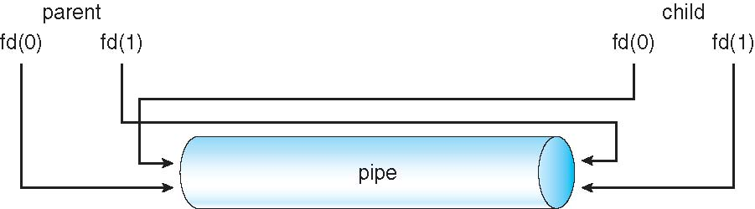
Ordinary Pipes

Slide 18
Named Pipes
Named Pipes are more powerful than ordinary pipes
Communication is bidirectional
No parent-child relationship is necessary between the communicating processes
Several processes can use the named pipe for communication
Provided on both UNIX and Windows systems

